Slide 1
New Machine Learning Program Recognizes Handguns in Even Low-Quality Video
Jingyue Shen

Slide 2
outcome
Handgun detection alert system that can be used on surveillance or control camera
capable of catching guns from even low-quality YouTube footage just under a quarter second

Slide 3
Keywords
Deep Convolutional Neural Networks
Transfer learning

Slide 4
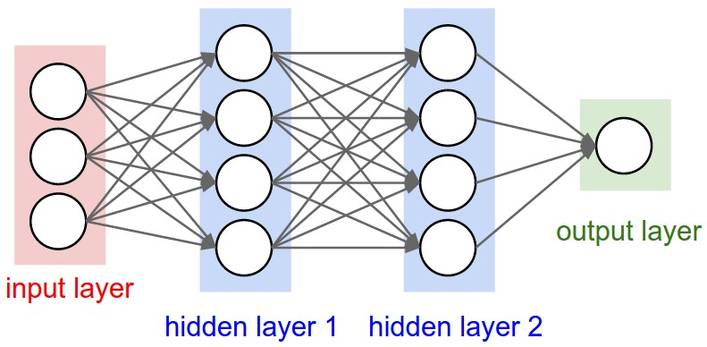


Neural Network
Activation unit
hypothesis
From one layer to another
Weights( θ )
Activation units( a_{i}^{(j)} )
Sigmoid function( )
Resulting hypothesis function(h_{θ} (x))

Slide 5
Neural Network
Activation unit
hypothesis
Cost function
Calculate gradient
Backward propagation algorithm
(calculate “error term” for each node and use them to find gradient of J(θ))

Slide 6

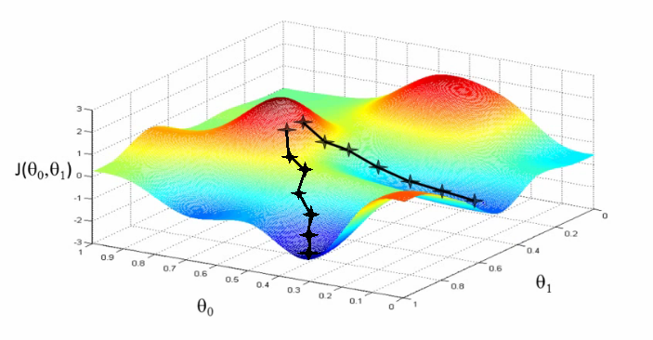
Neural Network
Activation unit
hypothesis
Update weights
Gradient descent
Θ_{t} = Θ_{t} - α
Repeat all processes until cost is relatively low

Slide 7
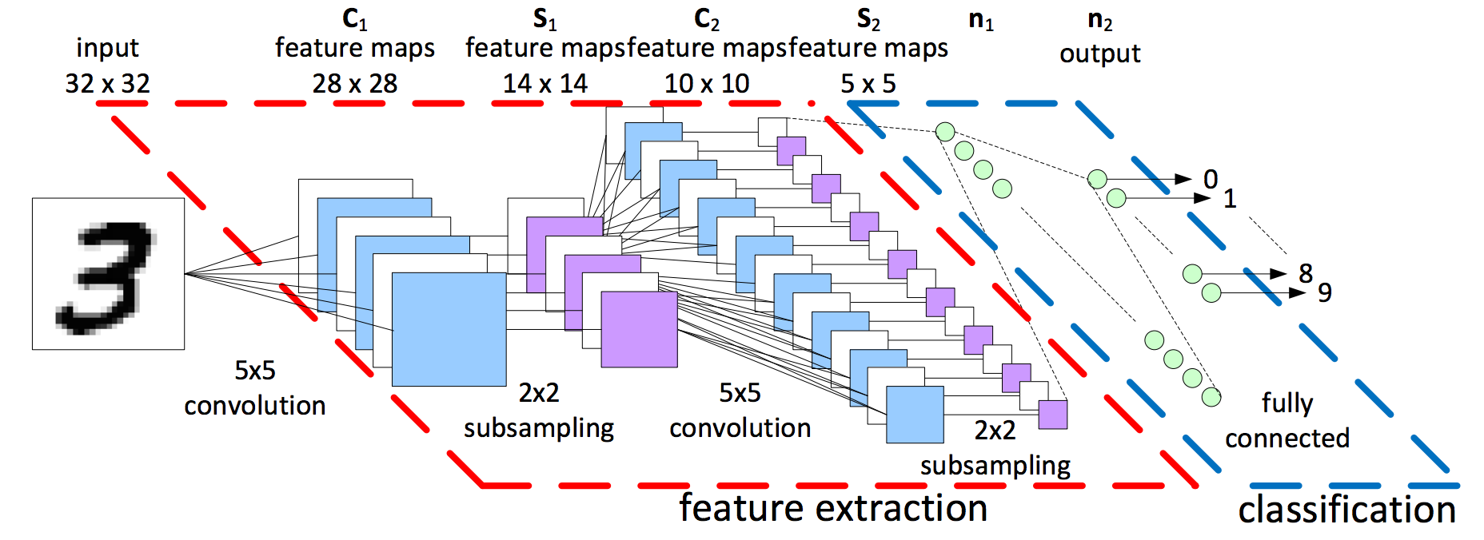
Deep Convolutional Neural Network (CNNs)
Far more complicated
Not fully connected
3D volumes of neurons
……
3 main types of layers(convolutional layer, pooling layer, fully-connected layer) stack together
……

Slide 8
Deep Convolutional Neural Network
But……

Slide 9
Deep Convolutional Neural Network
Have similar general procedures
Propagate forward to calculate the hypothesis(score)
Propagate backward to calculate gradient
Use the gradient to update weights

Slide 10
Typical Solution & Challenges
Convolutional Neural Networks(CNNs)
Millions of training images
Researchers only have 3000 images of pistols
(extracted from online gun catalogues, gun use tutorials and gun advertisement)

Slide 11
Solution
Transfer Learning
creation of visual recognition models even when data is scarce
use knowledge about one category of thing and apply that to other related category.
(“fine tune” an existing related model)

Slide 12
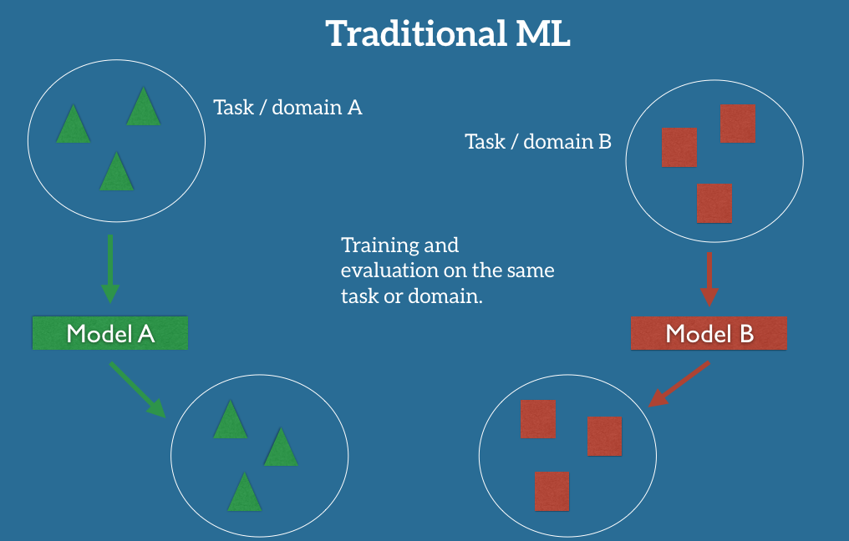
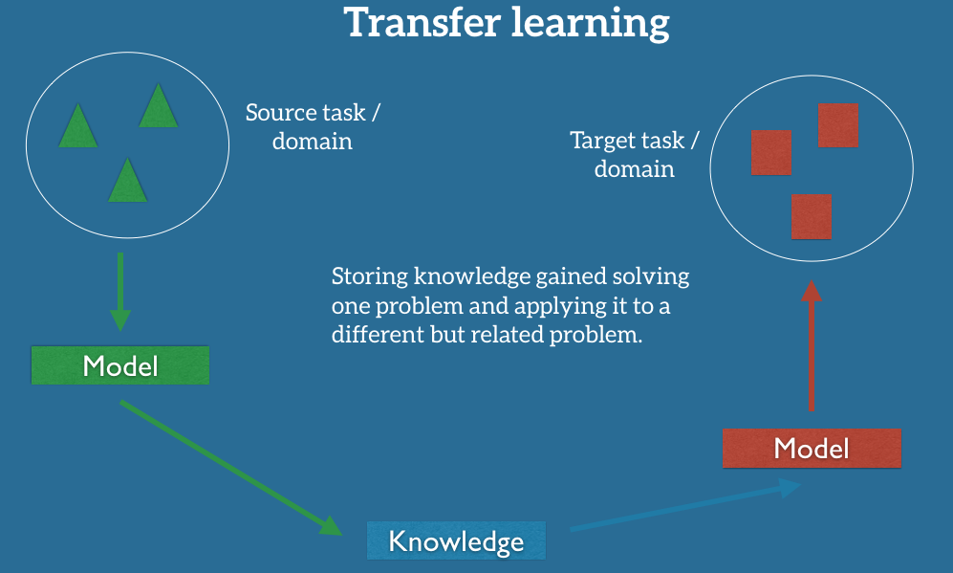

Slide 13
Classifier Model Used
VGG-16
144million parameters, trained based on a 1.28 million image dataset known as ImageNet
Can classify input images with respect to 1,000 different object classes

Slide 14


Training Classifier
Training
Prediction loss minimization
Stochastic Gradient Descent
Cost function
weight decay
weight
#data instances
Loss function
Input images
output class labels

Slide 15
Whole Process
Train VGG-16 classifiers based on manually-constructed different new datasets
Object detection process
run it on a number of areas of the input image using
sliding window approach
region proposals approach
Goal: minimize the number of false positives while reaching a near-real-time detection

Slide 16
Achievement
Accuracy :between 90% and 95%
Eliminate almost all false positive
Has significant set of false negative due
to very low contrast and luminosity
Reaction time: can recognize pistols even in low-quality video under a quarter second

Slide 17
Example of correct prediction

Slide 18
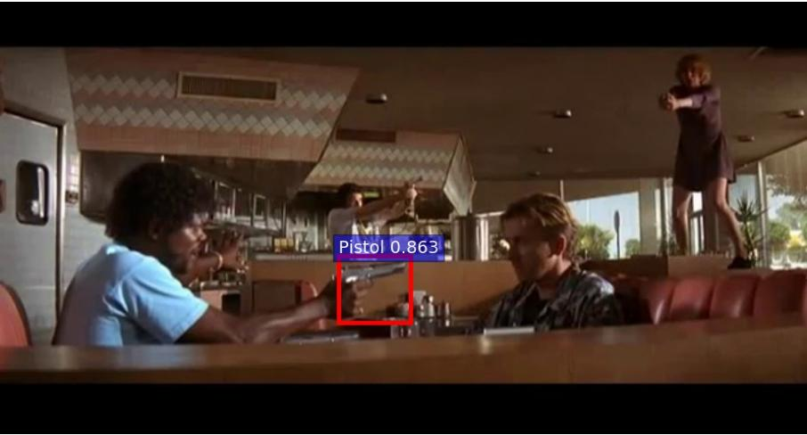
Example of False Negative

Slide 19
Conclusion
Fill in the gulf between ultra high-tech and crudely obvious approach.
NYPD testing a system that tracks guns based on the radiative signatures of human bodies
a firm called Shooter Detection Systems is pushing a system that automatically detects and reports gunfire: "a smoke alarm for gun fire detection."
Though computationally taxing, doing pistol recognition is really quick

Slide 20
Reference
Simple Neural Networks
https://www.coursera.org/learn/machine-learning/programming/AiHgN/neural-network-learning
Convolutional Neural Networks
http://papers.nips.cc/paper/4824-imagenet-classification-with-deep-convolutional-neural-networks.pdf
ttp://cs231n.github.io/convolutional-networks/#overview
The researchers work
https://arxiv.org/pdf/1702.05147.pdf

Slide 21
Thank you!

